Slide 1
IA2: Pulse Modulation
A – 2 / 16014022050 / Ketaki Mahajan
Notes:
Hello everyone. In this presentation I will be delving into the intricacies of different pulse modulation techniques such as Pulse Amplitude Modulation (PAM), Pulse Width Modulation (PWM), and Pulse Position Modulation (PPM).

Slide 2
Pulse Amplitude Modulation
Notes:
Lets first start with Pulse Amplitude Modulation also known as PAM.

Slide 3
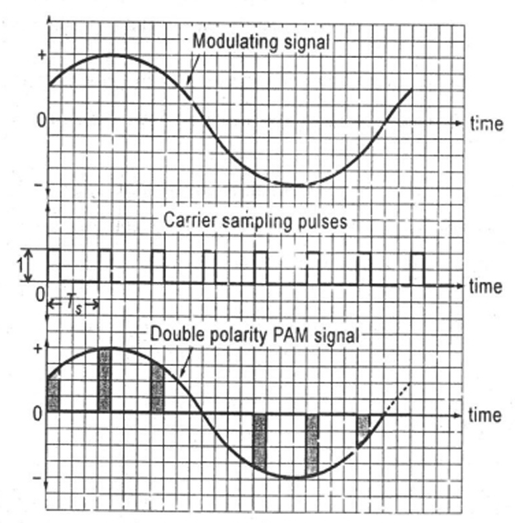
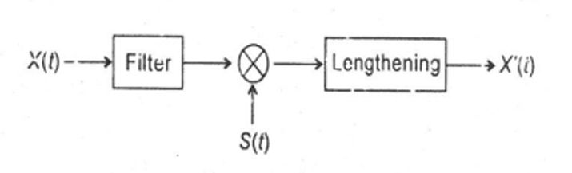
Pulse Amplitude Modulation (PAM)
PAM is a pulse modulation system in which amplitude of the digital carrier is varied according to amplitude of the baseband signal.
The mathematical model of PAM modulator:
Waveforms of PAM
Notes:
PAM is a method of modulation where the amplitude of a series of pulses is varied according to the instantaneous amplitude of a modulating signal, often referred to as the baseband signal.
Imagine you're sending a series of pulses down a wire. In PAM, the height of each pulse represents the value of the original signal at that moment. So, if the baseband signal is high, the amplitude of the pulse will be large; if it's low, the amplitude will be small.
Mathematically, we represent a PAM modulator as a series of operations. We start with low-pass filtering to prevent aliasing, then we perform ideal sampling or multiplication, and finally, we lengthen the duration of each sample. Lengthening the duration helps reduce the required transmission bandwidth and ensures that we capture the exact signal value.

Slide 4
Operations performed by PAM
Low-pass filtering to prevent aliasing
Ideal sampling or multiplication (it takes two signals)
Lengthening the duration of each sample. The use of lengthening is –
To reduce the required transmission bandwidth (BW). Since it is inversely proportional to pulse duration.
To get the exact signal value.
Notes:
As, mentioned in the previous slide, the operations performed by PAM include…

Slide 5
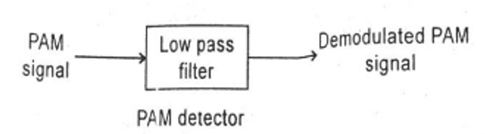
PAM Generation Circuits and Demodulator
PAM Generation Circuits
PAM Demodulator
Natural sampling
Flat top sampling
It is done by passing it through a low pass filter.
Notes:
Now, let's take a look at how we generate and demodulate PAM signals.
PAM generation circuits include techniques like natural sampling and flat-top sampling. These methods allow us to accurately capture the amplitude variations of the baseband signal.
Demodulation of PAM signals typically involves passing the modulated signal through a low-pass filter. This filter helps extract the original baseband signal from the modulated waveform.

Slide 6
Advantages and Disadvantages of PAM
Very simple system.
Effect of noise is maximum on PAM systems as energy is stored in amplitude.
High bandwidth.
Transmitted power is not constant.
No synchronization between transmitter and receiver required.
Notes:
Advantages of PAM include its simplicity and the fact that no synchronization between transmitter and receiver is required.
However, PAM systems are susceptible to noise, as the energy is stored in the amplitude, and they require a high bandwidth due to the varying amplitudes of the pulses.

Slide 7
Applications of PAM
It is mostly used in Ethernet communication.
Used by many microcontrollers to create control signals.
It is employed in photobiology.
It functions as a driver for LED circuits.
Notes:
READ SLIDE
Few of the application of PAM include…

Slide 8
Pulse Width Modulation
Notes:
Moving on to pulse width modulation, also known as PWM.

Slide 9
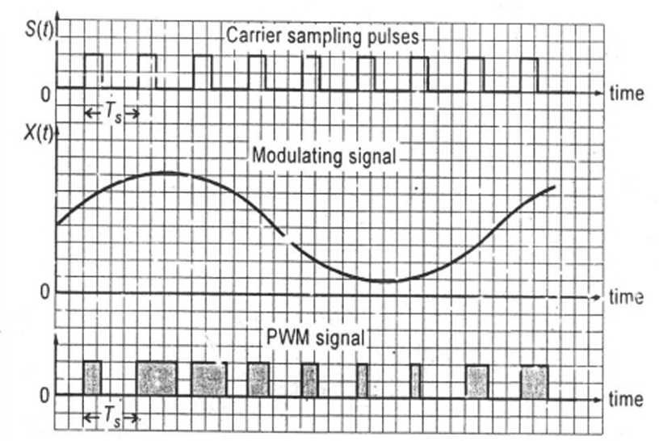
Pulse Width Modulation (PWM)
In pulse width modulation, width of pulse of digital carrier is varied in accordance with the amplitude of the baseband signal.
Hence, the information is contained in the width.
PWM signal
Notes:
PWM is a modulation technique where the width of the pulses in a train of constant amplitude pulses is varied according to the amplitude of the modulating signal.
Instead of changing the height of the pulse like in PAM, in PWM, we change the width of the pulse. So, a high amplitude in the baseband signal will result in a wider pulse, while a low amplitude will result in a narrower pulse.

Slide 10
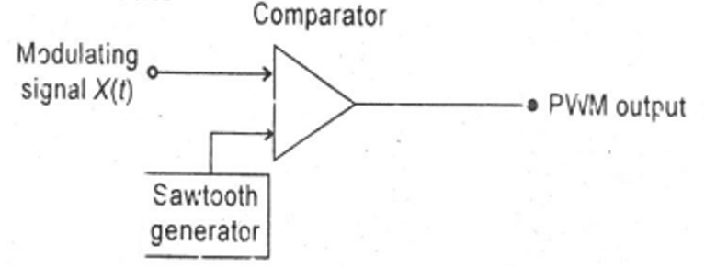
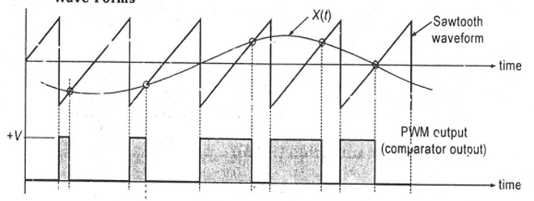
PWM Generation Circuit
Generator circuit:
Comparator compares the two signals. If the voltage X(t) is higher than the sawtooth waveform voltage, it gives positive voltage V for that much time.
Hence, we can see the pulses are of the variable length.
Waveforms
Notes:
The PWM generation circuit typically involves a comparator that compares the baseband signal with a sawtooth waveform.
Depending on the result of this comparison, it generates pulses of variable width.

Slide 11
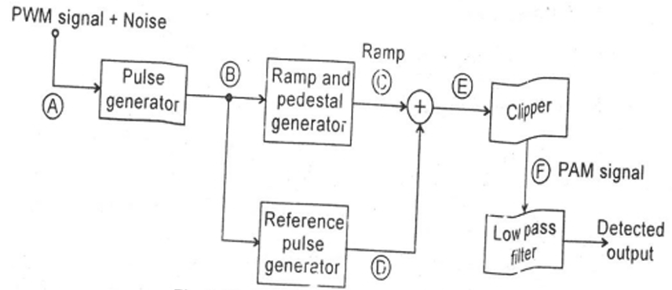
PWM Demodulator
Pulse generator removes the effect of noise to give waveform B.
Ramp and Pedestal Generator generates flat top when B waveform voltage is low and slant edge when B waveform voltage is high.
Reference Pulse generator generates a pulse after delay.
After adding C and D, we get E waveform.
Clipper shifts the DC reference level to V1 after clipping we get a PAM waveform signal.
Now, the original signal can be easily recovered from PAM signal by passing it through low pass filter.
Notes:
Demodulating PWM signals involves components like a pulse generator and a ramp and pedestal generator. These elements help to recover the original signal from the modulated waveform.

Slide 12
Advantages and Disadvantages of PWM
Good noise immunity.
Variable power.
Hight bandwidth.
Synchronization between transmitter and receiver is required.
Notes:
PWM offers good noise immunity and variable power transmission, but it requires synchronization between transmitter and receiver and has high bandwidth demands.

Slide 13
Applications of PWM
Drive a buzzer with varying levels of volume.
Control the motor's speed.
Control the movement of a servo.
Make an analogue output available.
Create an audio signal.
Message encoding in telecommunications.

Slide 14
Pulse Position Modulation
Notes:
Finally, let's discuss Pulse Position Modulation, or PPM.
PPM is a modulation technique where the position of the pulse in a pulse train is varied according to the amplitude of the modulating signal.

Slide 15
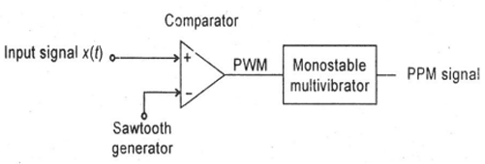
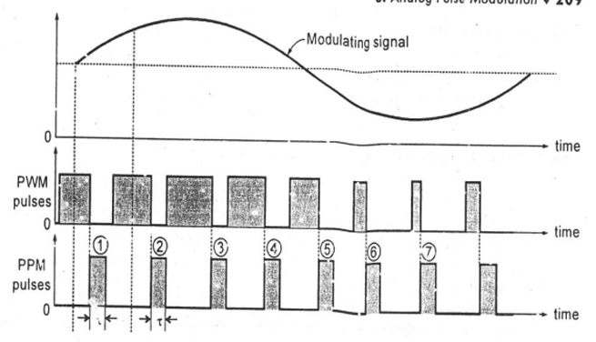
Generation of PPM from PWM
PPM can be easily generated from PWM.
Attach a monostable multivibrator to the end of PWM generator to get PPM signal.
Monostable multivibrator generates a pulse with width 𝜏 at every falling edge.
From the waveform, we can easily see that a PPM can be easily generated from PWM.
Generation of PPM Signal
PPM pulses generated from PWM signal
Notes:
Now, let's explore how Pulse Position Modulation (PPM) can be easily generated from Pulse Width Modulation (PWM).
To create PPM from PWM, we attach a monostable multivibrator to the end of the PWM generator.
At every falling edge of the PWM signal, the monostable multivibrator generates a pulse with a fixed width, represented by the symbol 𝜏. This pulse becomes the position marker in our PPM signal, indicating when the information is transmitted.
From the waveform, it's clear to see how PPM can be easily generated from PWM.

Slide 16
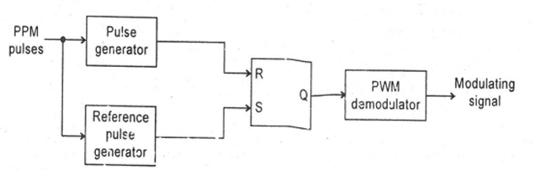
PPM Demodulator with Help of PWM
The SR flip-flop, pulse generator and reference pulse generator converts the PPM signal to PWM signal which is then demodulated by PWM.
PPM demodulator circuit
Notes:
We use three key components: an SR flip-flop, a pulse generator, and a reference pulse generator. Together, they work to convert the PPM signal into a PWM signal, which is then demodulated.
The SR flip-flop acts like a switch, allowing only certain signals to pass through based on their timing. The pulse generator shapes the waveform to match the original PPM signal, while the reference pulse generator helps guide this process.
By using PWM as an intermediary, we simplify the demodulation process.
Through this method, we're able to decode PPM signals effectively, turning them into meaningful information that we can understand.

Slide 17
Advantages and Disadvantages of PPM
High noise immunity.
Synchronization between transmitter and receiver is required.
High bandwidth.
Constant power.
Notes:
PPM offers robust noise immunity and constant power transmission, it requires synchronization between transmitter and receiver and has higher bandwidth demands.

Slide 18
Applications of PPM
It is utilized in air traffic control and telecommunications networks.
Pulse code modulation is used in remote-operated autos, planes, and trains.
It is used to compress data and, therefore, for storage.

Slide 19
Comparison between PAM, PWM and PPM
 | PAM | PWM | PPM
Type of carrier | Train of pulse | Train of pulse | Train of pulse
Information is stored in | Amplitude | Width | Position
Bandwidth | Low | High | High
Noise immunity | Low | High | Highest
Need to be sent with synchronized pulse | No | Yes | Yes
Transmitted power | Varies with amplitude of pulses | Varies with variation in width | Remains constant

Slide 20
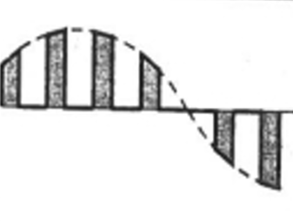
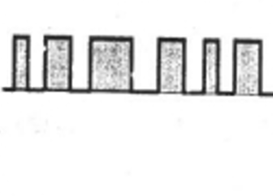
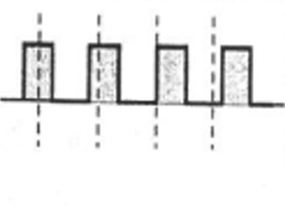
Comparison between PAM, PWM and PPM
 | PAM | PWM | PPM
Complexity of generation and detection | Complex | Easy | Complex
Similarity with other modulation systems | Similar to AM | Similar to FM | Similar to PM
Variable characteristics of the pulsed carrier | Amplitude | Width | Position
Output waveforms

Slide 21
Thank You!
Notes:
In summary, PAM, PWM, and PPM each have their strengths and weaknesses.
By understanding these techniques, we're better equipped to handle different communication needs. So, whether it's sending audio signals or transmitting data, pulse modulation techniques are key players in modern technology.
Thank you for joining me on this exploration of pulse modulation techniques!

